Slide 1
Analyzing Delivery Performance and profitability in supply chain
A data driven project in Excel
Presented by Jonemoni Kalita.
Tools Used: Excel | Power pivot | Pivot Chart

Slide 2
Problem Statement
Inefficiencies in supplier performance and delivery delays are driving up operational costs and reducing overall profitability. Identifying the root causes is critical for enhancing supply chain efficiency and customer satisfaction.

Slide 3
Hypothesis
Which suppliers have the highest demand, and how does that impact revenue, cost and profitability?

Slide 4
Project Objective
To analyze delivery outcomes and profitability across suppliers using Excel dashboard visuals and KPIs to uncover inefficiencies and improvement opportunities.

Slide 5
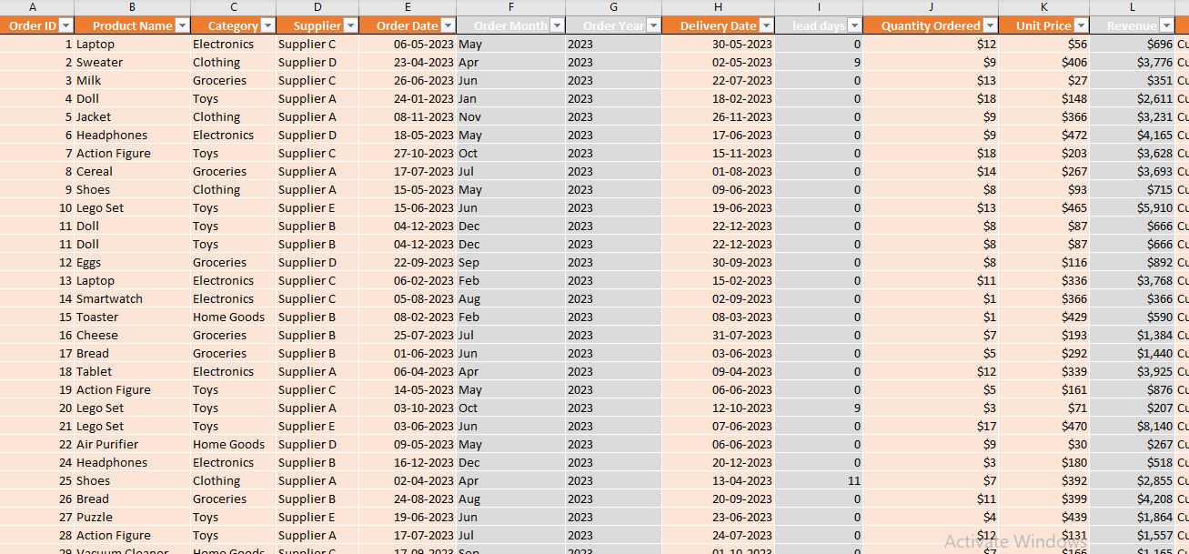
Dataset Overview
Dataset Summary:
Size: 10,000 rows 18 columns
Key columns: OrderID, Supplier, Order Date, Lead Days, Revenue, Cost , profit, Delivery Status.
No. of orders :9689
Only 1975 orders delivered(20.38%)
Profit = 1.4 million

Slide 6
Data cleaning and categorization
Removed blanks and duplicates.
Calculated new fields: On time delivery, Revenue, Profit, Lead time
Grouped delivery status into three categories- On time(Successful within 10 days), Delayed(successful after 10 days of order) and Pending(shipped, pending, cancelled, returned, undelivered).
Lead days calculated.
On time indicator created.
Profit and Revenue calculated.
Handled negative profit carefully.
Zero revenue and profit for products that were cancelled, returned, Pending, shipped.
This led to accurate profitability analysis focused on actual sales.

Slide 7
KPIs and Dashboard design
KPIs: Total Orders, On Time Delivery Rate, Total Revenue, Total Profit, Total Delivered Orders.
Slicers : Delivery Status, Supplier, Year, Month.

Slide 8
Key insights : Cost vs Profit vs Revenue
Supplier D has the most orders and most successful and most unsuccessful orders.
Supplier D has highest total cost and highest profitability
Highest revenue comes from delayed orders, suggesting penalties or urgent changes.

Slide 9
Delivery Performance
Pending Deliveries are the highest followed by delayed.
December 2023 had peak delays, likely due to holiday demand.
Most of the products were returned ,cancelled,pending, shipped .
Most Delayed Category: Home Goods
Least Delayed Category: Toys

Slide 10
Supplier analysis
Supplier with highest delay E.
Supplier with lowest delay C.
Avg. lead time: Supplier A quickest

Slide 11
Final insights
Supplier D has both best and worst performance: high volume but low delivery success. Also highest revenue and profit.
Profitability is tightly linked with delivery efficiency.
Delivery delays peak during December, indicating seasonal impact.

Slide 12
Business Impact & Recommendations
Prioritize high delay suppliers for process improvements.
Review penalties/ incentives related to delayed orders.
Focus on supplier D’s delivery rate to turn high demand into real profit.
Focus supplier strategy on Supplier C for reliability.
Investigate Supplier E's delay-profit paradox — explore scalable best practices.
Reduce dependency on Supplier D or negotiate penalty clauses for non-delivered orders.
Prioritize Home Goods for delivery process optimization.

Slide 13
Conclusion
Delivery success plays a crucial role in driving profitability. The dominance of pending and delayed orders highlights the need for better tracking and supplier accountability. December delays point to seasonal capacity issues. Strategic improvements in supplier performance and delivery planning can turn losses into profitability.

